Slide 1


Slide 2

HOSPITAL MANAGEMENT SYSTEM

Slide 3

ABSTRACT :
Hospital Management System is an organized computerized system designed and programmed to deal with day-to-day operations and management of hospital activities.
The program can look after inpatients, outpatients, records, database treatments, status illness, billings in the pharmacy, and labs.
It also maintains hospital information such as ward id, doctors in charge, and department administering.
In this project, we are going to provide the extra facility to store the report in the database and make it available from anywhere in the world

Slide 4

INTRODUCTION :
The project Hospital Management system includes registration of patients, storing their details into the system, and also computerized billing in the pharmacy, and labs.
The software has the facility to give a unique id for every patient and stores the details of every patient and the staff automatically.
It includes a search facility to know the current status of each room.
Users can search the availability of a doctor and the details of a patient using the id
The Hospital Management System can be entered using a username and password.
It is accessible either by an administrator or receptionist.Only they can add data into the database.

Slide 5
LITERATURE REVIEW 1 :
International Journal For Research In Engineering Application & Management (IJREAM)
ISSN : 2494-9150 Vol-01, Issue 11, FEB 2016
One of the major challenges existing hospital management systems face is around operational efficiency and wait times between different processes, departments and persons. This paper highlights such limitations of existing systems and proposes a RFID(Radio Frequency ID) and wireless sensor based , location and information management framework that facilitates real time tracking of hospital assets, personnel and patients as they move through pre-set procedures as part of daily activities of the hospitals. The system covers the visual simulation and providing ability to analyse the ongoing operations so they can be corrected to achieve increased process efficiency and service levels.

Slide 6
LITERATURE REVIEW 2 :
International Journal Of Advanced Research In Computer And Communication Engineering Iso 3297:2007 Certified Vol. 6, Issue 1, January 2017
Generally Hospital Management Information Systems Have The Function Of Patient Are And Hospital Management . These Functions Include: Keeping Information About The Patients, Generating Bill, Maintenance Schedule Of Equipments In The Hospital, Recording Information Related To Diagnosis Given To Patients, Keeping Record Of The Immunization Provided To Patient, Keeping Information About Various Diseases And Drugs Available To Treat Them Etc.. Previously, All These Different Functions Are Done By Operational Cadre And Doctors Manually On Paper . With The Increase Of Demands On Health Care Services Because Of Increasing In Population Paired With Increasing Attention Over Patients' Safety.

Slide 7

LITERATURE REVIEW 3:
Hospital Management System Using Web Technology,
Published : June -2020 ;Assistant Professor ,Lakshmi ,
Reva University, Bengaluru, India
The primary objective of this project is to define, implement and build a system which offers support for the hospital management, that can be fulfilled only thorough achieving the secondary objectives that will be presented next. A user is considered to be efficient when using a system if the time necessary to execute a certain task decreases with each usage. The system should be able to offer the opportunity to manage patient details, doctor’s details, schedule appointments, view prescriptions, order medicines online and make online payments. This project has focused on reducing the amount of paperwork involved and also reducing the time involved in these processes.

Slide 8

LITERATURE REVIEW 4: Hospital Management System ,Published: May 2018 Matarlo, Marlou J. And ONIOT, JOHN BARTH Southern Philippines Agri-business
Hospital Management System is powerful, flexible, and easy to use and is designed and developed to deliver real conceivable benefits to hospitals. Prasanth and Sailaja stated that hospital management system is to computerize the front office management which deals with collection of patient information, diagnosis details, and even the billing details. The researchers have found out that the computerization of hospital management system has become a necessity and has become the new standard. By implementing this technology adoption, the researchers also found out that the need of easy access to patient information and history are significantly increasing.

Slide 9

LITERATURE REVIEW 5: Hospital Management Maturity Models Published: October 2021,Luciano Trentin, Gerson Tontini
The maturity model has become an established and important instrument to guide organizational transition initiatives (Batenburg, Neppelenbroek, & Shahim, 2014). Maturity models are established on the principle of periodic growth stages, in which the changes of an organization over time, are organized in a continuous and calculable way, covering an established number of cumulative and orderly continuous stages .The hospital segment is a complex, dynamic and specialized ecosystem, and the establishment of thoughts through processes and its effective management requires the right tools and the support of a mature organizational culture.

Slide 10
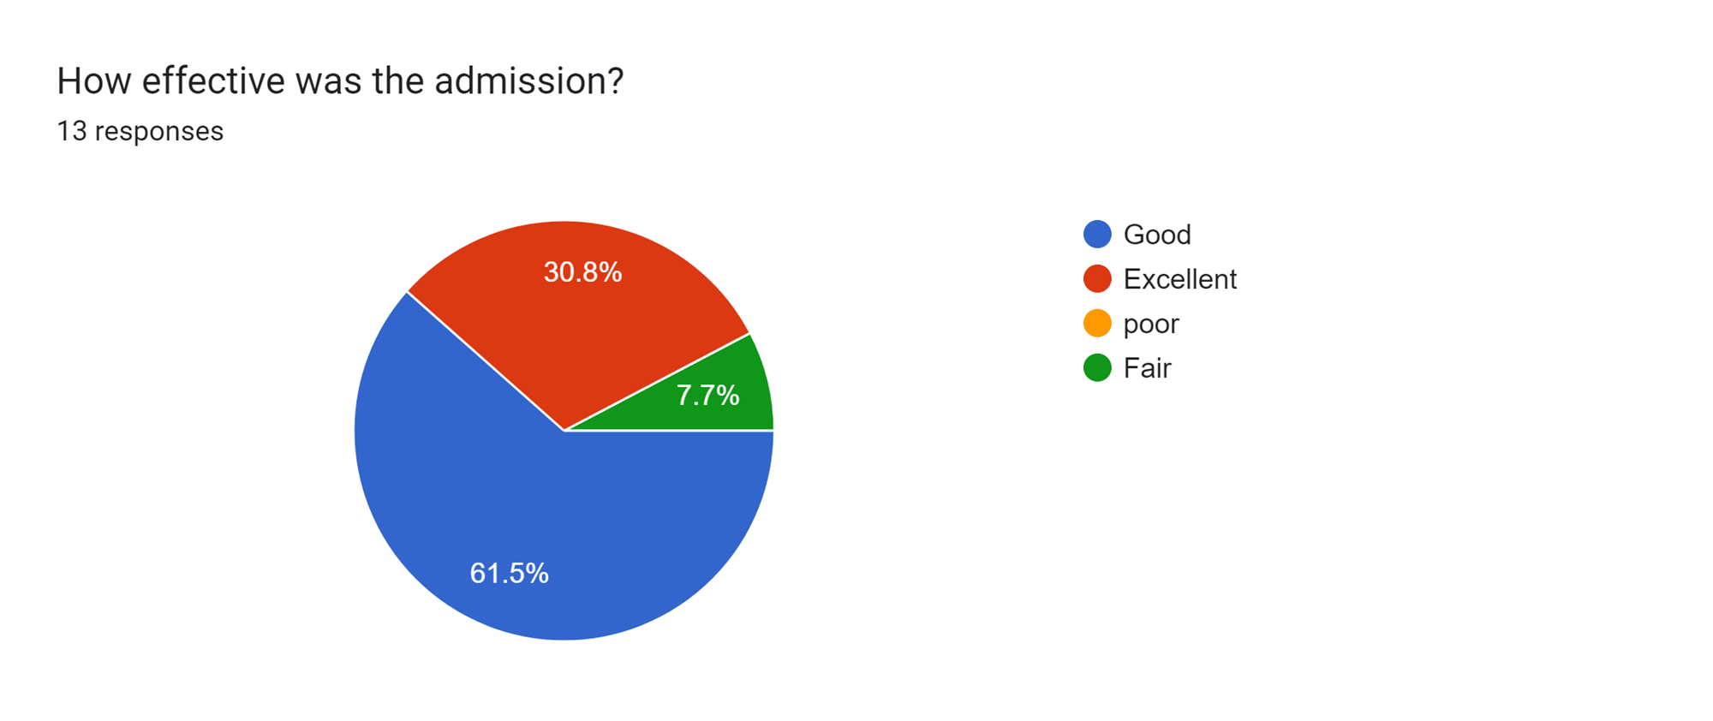
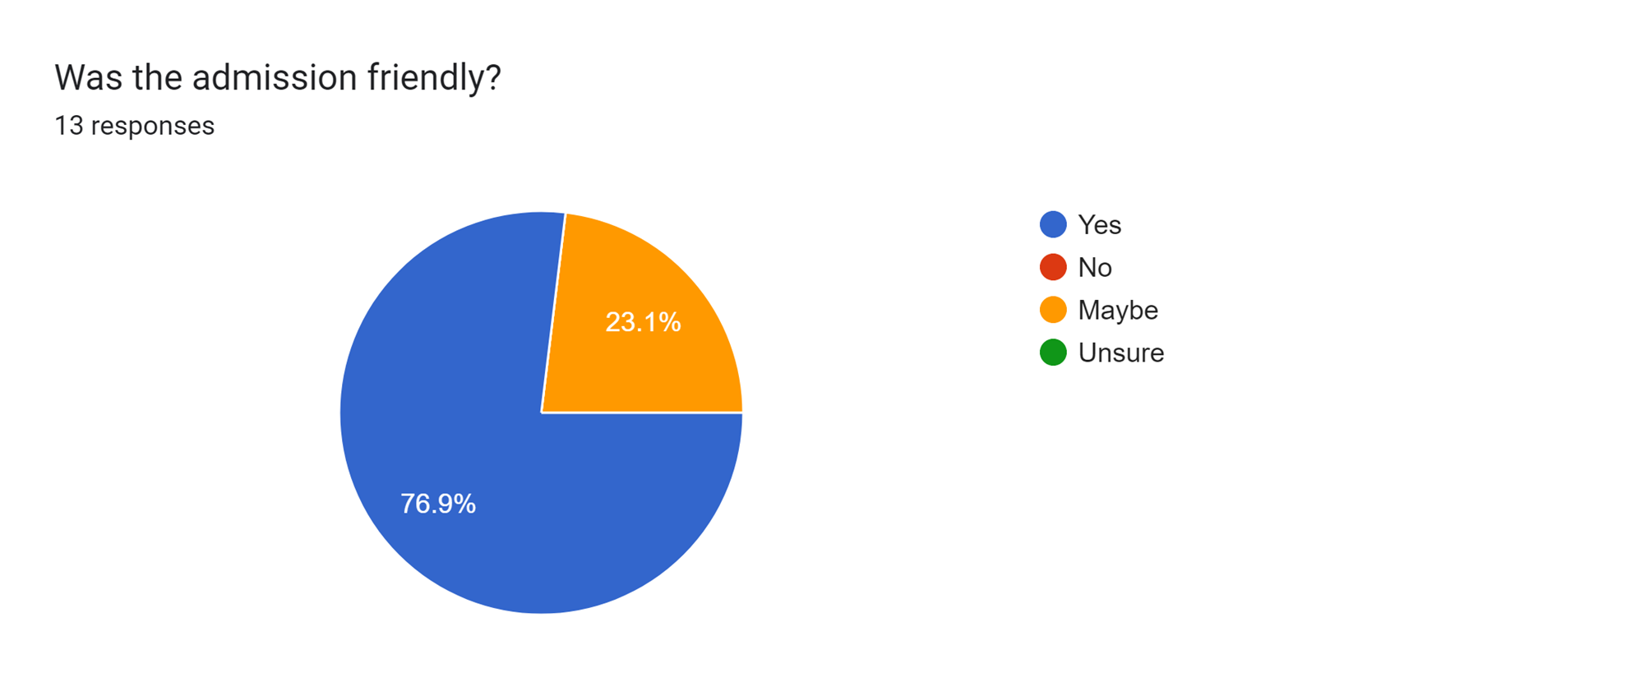

Slide 11
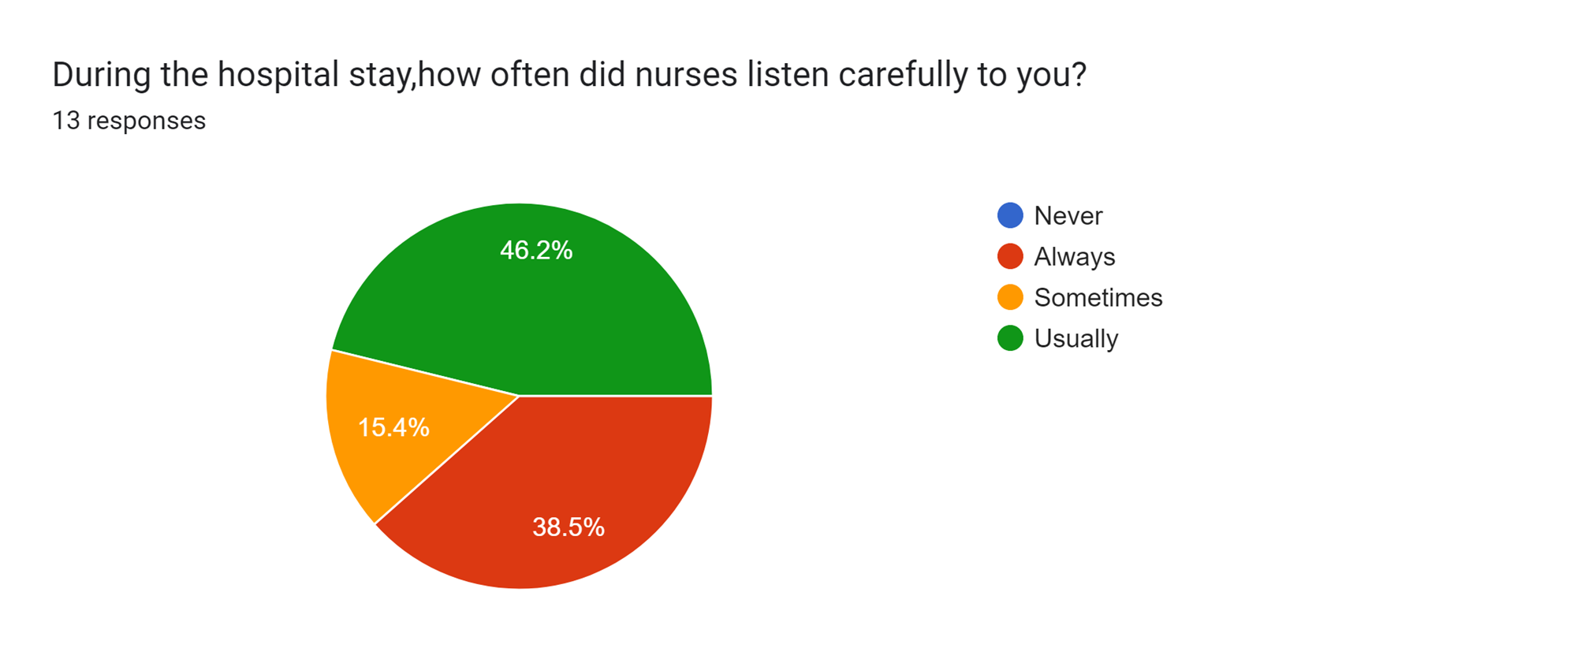
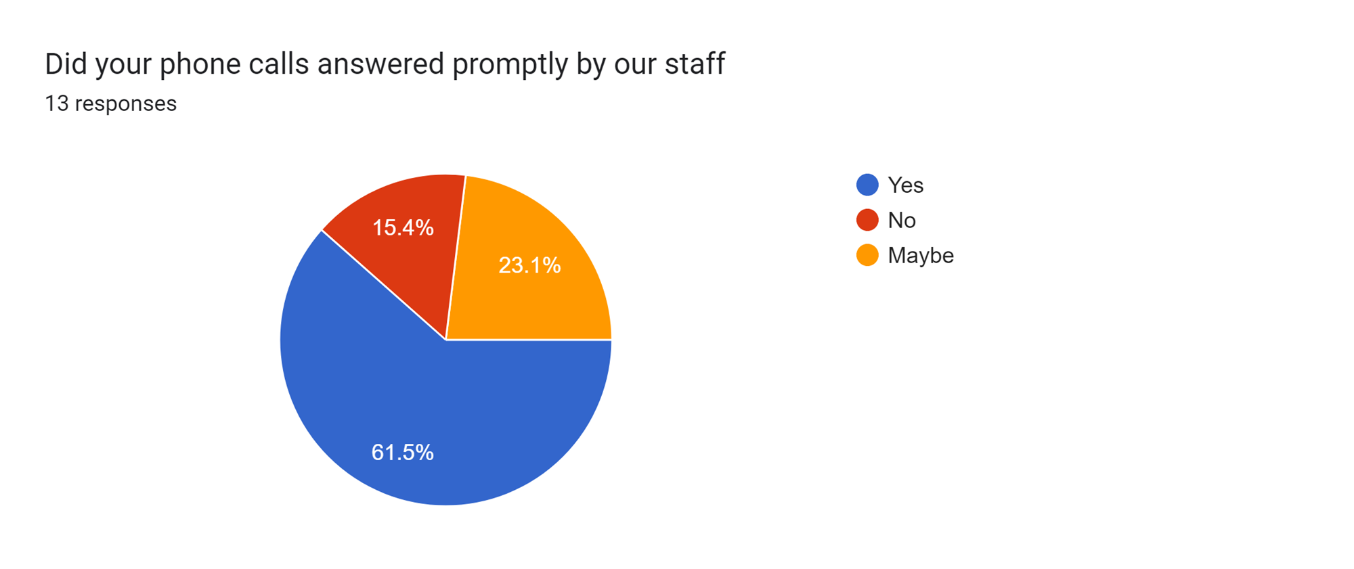

Slide 12
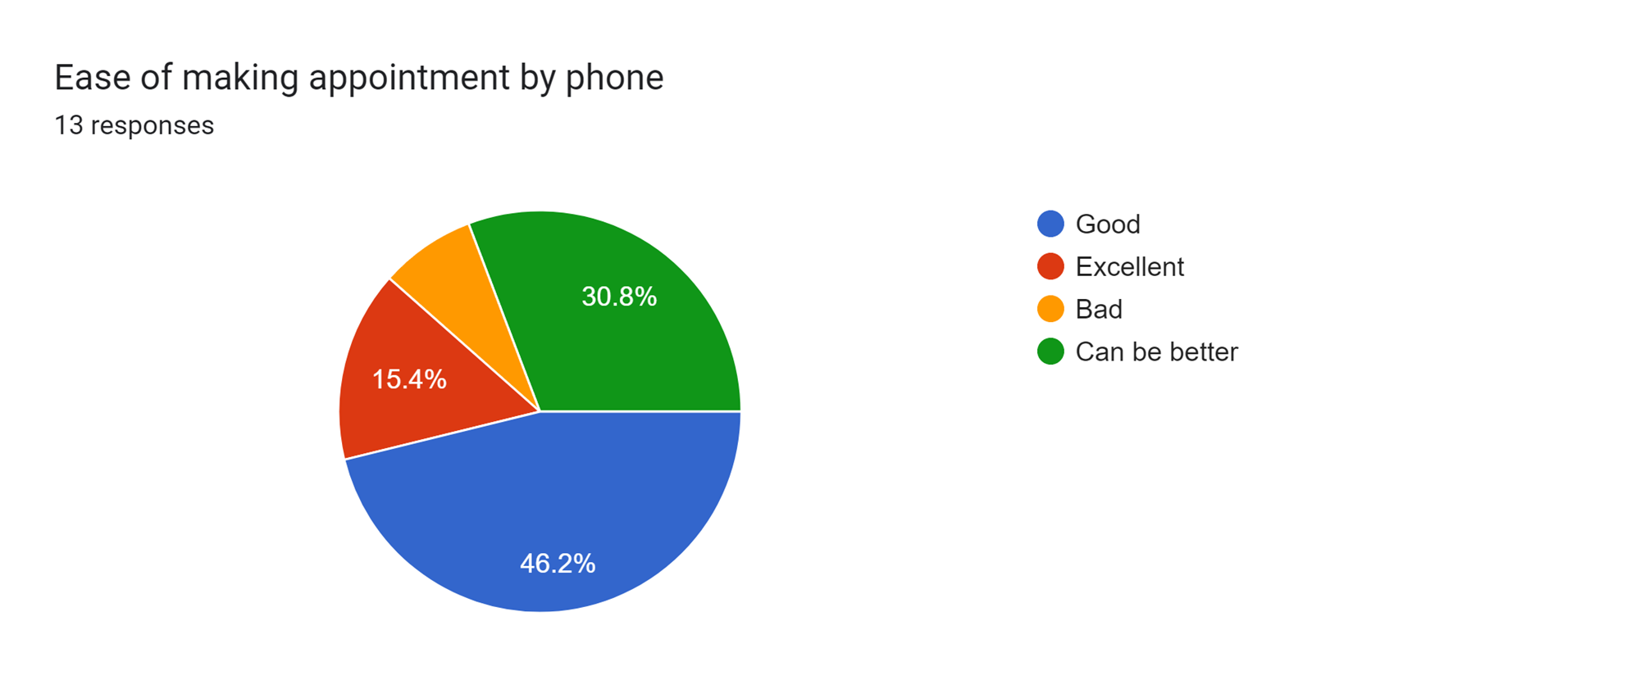
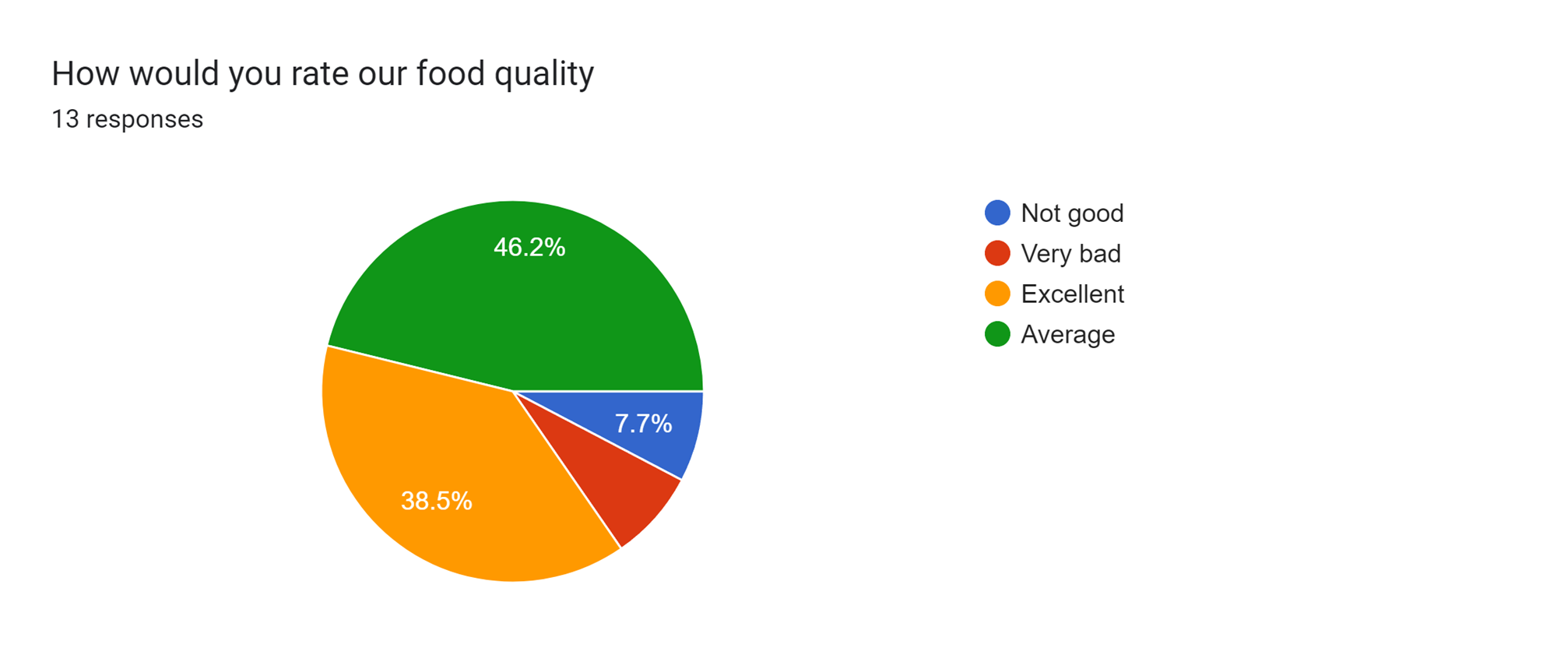

Slide 13
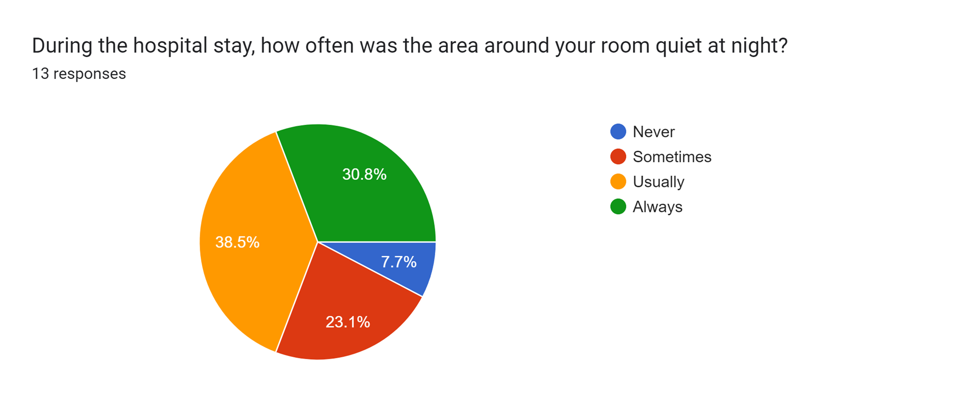
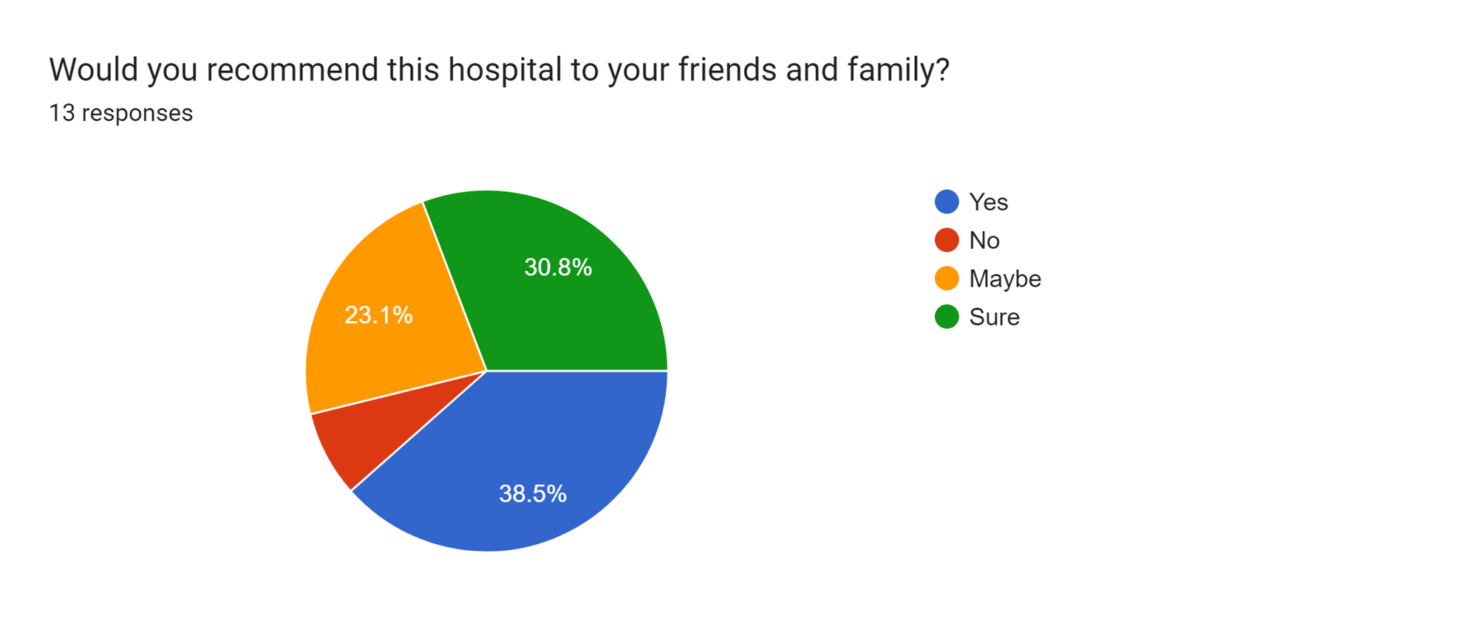

Slide 14
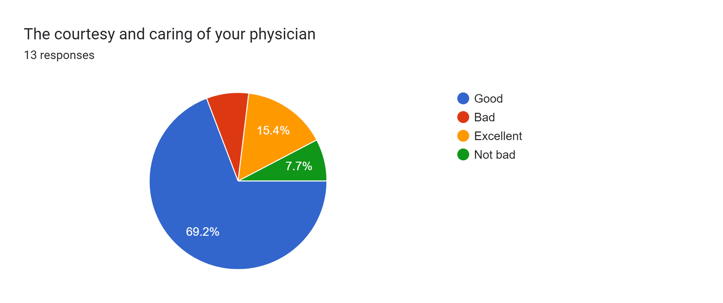
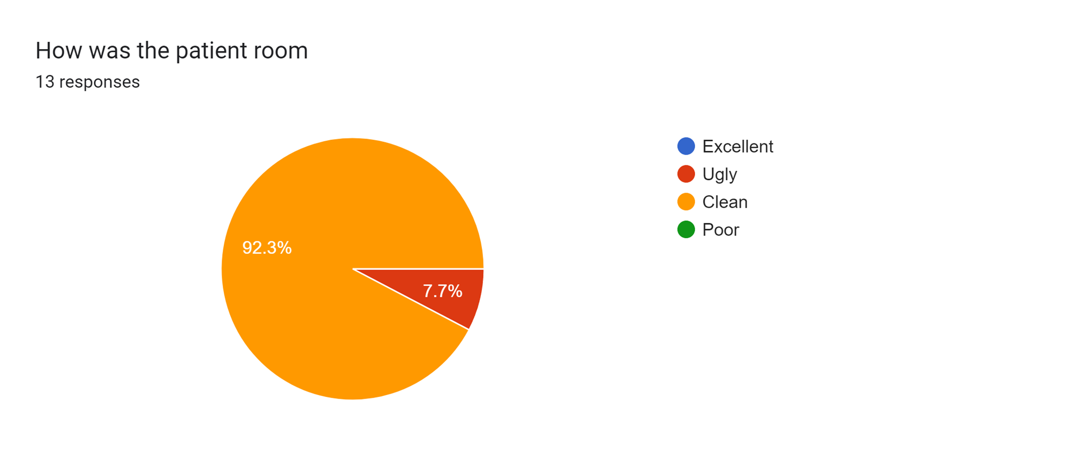

Slide 15
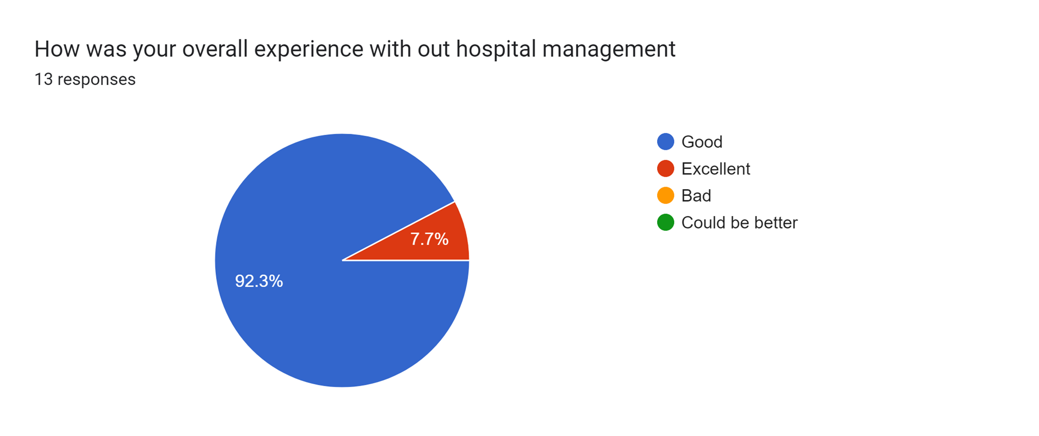
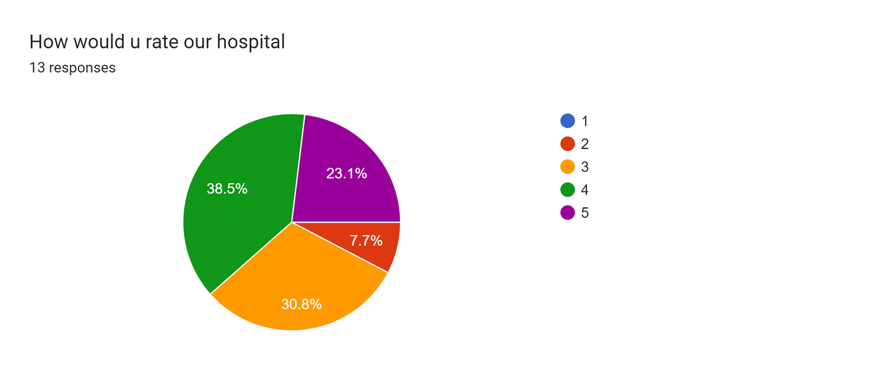

Slide 16
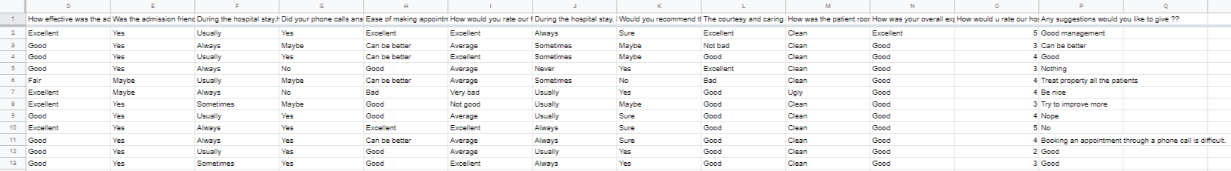
Tabular representation Of The Survey

Slide 17

OBSERVATION AND RESULT:
The above conducted survey shows that the Management that is carried by the Hospital:
It shows that the admission was effective and friendly
It shows that during the hospital stay the nurses were friendly with the patients and the rooms were quiet at night
It shows that the phone calls are answered promptly by our staff
It shows that our patients overall experience is good in our hospital.

Slide 18
CONCLUSION:
The conclusion of this project is the Hospital Management System is essential for maintaining detail about the Doctor, Patient, Hospital staff etc. we understand that by using of Hospital Management System project the work became very easy and we save lot of time. Hospital administrators would be able to significantly improve the operational control and thus streamline operations. This would enable to improve the response time to the demands of patient care because it automates the process of collecting, collating and retrieving patient information. Accounting sometimes becomes awfully pathetic and complex. This product will eliminate any such complexity.

Slide 19
REFERENCES:
[1] Herbert Scheldt, Java Complete Reference, Fifth Edition, Tata McGraw Hill Edition.
[2] Phil Hanna, JSP 2.0: The Complete Reference, Tata McGraw Hill Edition.
[3] Elmarsi and Navathe, Fundamentals of Database System (Third Edition), Addision Wesley.
[4] Ian Somerville, Software Engineering, Third Edition, Pearson Education
[5] Ali Bahrami, Object-Oriented System Development, Third Edition, Tata McGraw Hill Edition.

